Slide 1


BIG DATA
Final Project
By: Abdelrahman Karam

Slide 2
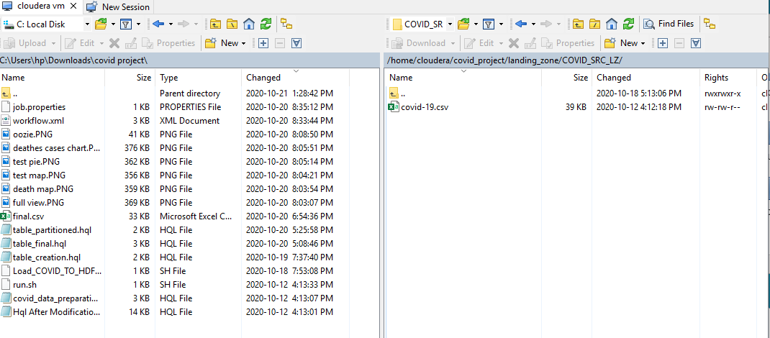
Preparations
Before starting we needed to copy the date files from the main OS to the VM, so to do that we used WINSCP APP as shown below

Slide 3
First stage: ingestion
By ingestion we mean to put the data file in the HDFS
For that we run the shell script file included named ” Load_COVID_TO_HDFS”

Slide 4
Second stage: storage
We used Hive to store the data and to do that we ran some HQL files
First, we created the table and read the data from HDFS into it
Then, to make it easier to deal with data by using partitioning based on country name
For these 2 steps we used the HQL files “table_creation” and “table_partitioned”

Slide 5
Third stage: processing
For the task required we need to do some simple processing to get the countries with top deaths and tests
To get those countries we used the hql method rand on these columns
As these columns were strings with extra symbols like “ we cleaned them using a regular expression and then cast them to integers before ranking based on them
After that we export the output to be visualized
HQL source in “table_final” file

Slide 6
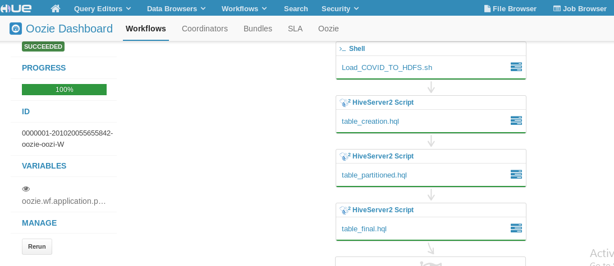
Forth stage: automation
For the automation we simply used the HUE website the uses OOZIE
We created a workspace and added the 4 files mentioned before in order
We let it run until the run succeeded as shown below

Slide 7
Fifth stage: visualization
For the visualization we used Power BI website platform
In the next few slides we will show each graph with the details

Slide 8
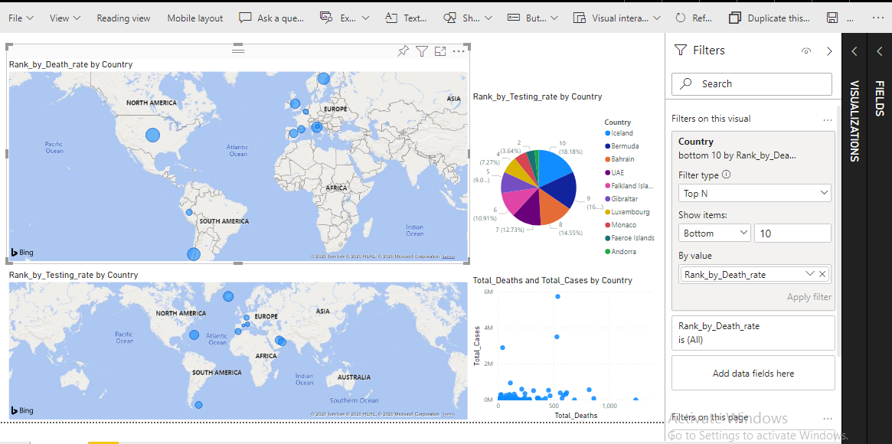
TOP death rate (map)
Including countries and rank by death rate and taking top 10 results

Slide 9
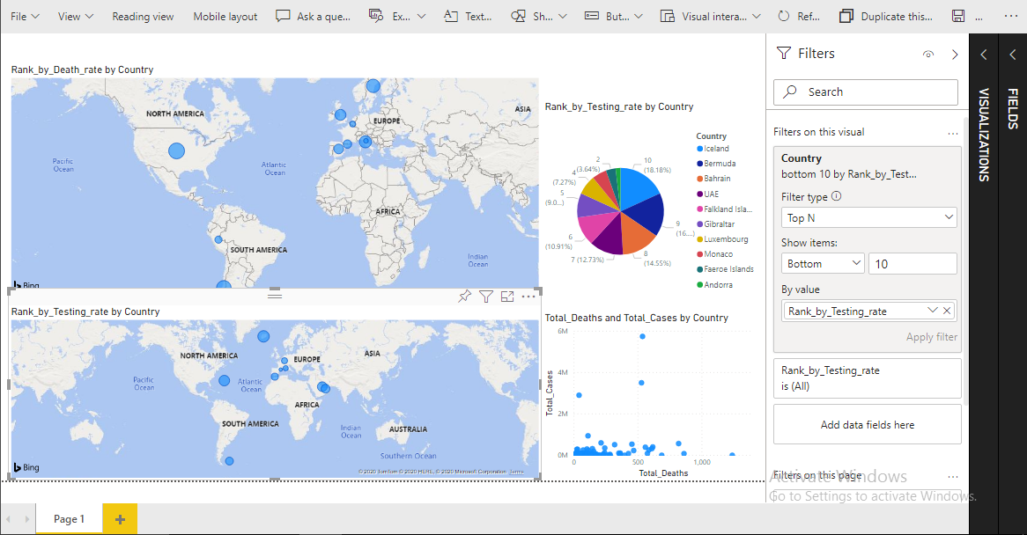
Top test rate(map)
Including countries and top test rate columns and taking top 10 results

Slide 10
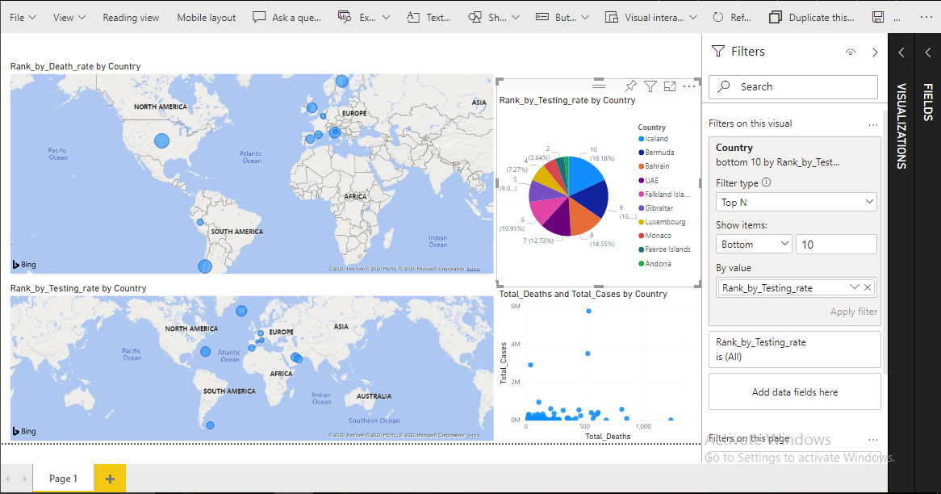
Top test rate (pie chart)
Same as the previous one but using pie chart

Slide 11
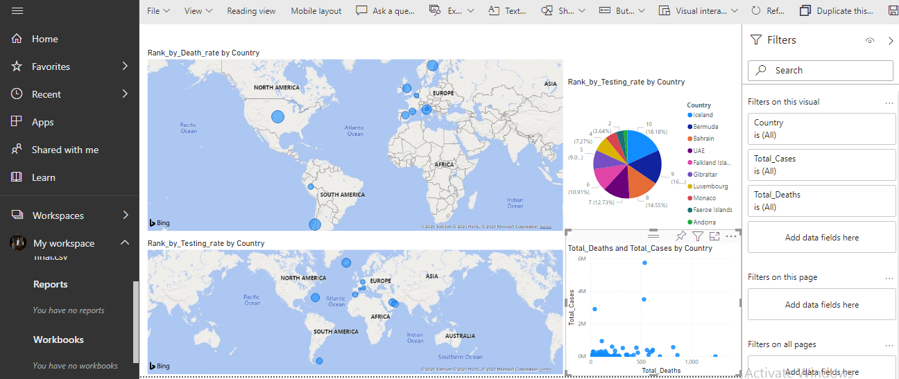
Deaths-cases relation chart
This chart shows the relation between cases and deaths in each country

Slide 12
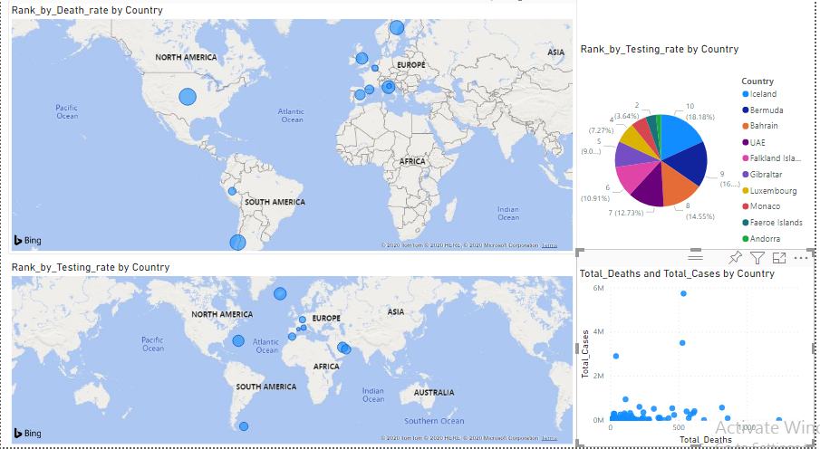
Full view

